Slide 1
Contents
Task Pages
Resources
Help
AVID eBinder
Insert Name Here

Slide 2
Table of Contents
Contents
Task Pages
Task Page 1 Task Page 2 Task Page 3
Resources
Task Page Template Learning Artifacts Focused Note-Taking Overview Two-Column Notes Three-Column Notes Cornell Notes
Help
Task Pages
Resources
Help

Slide 3
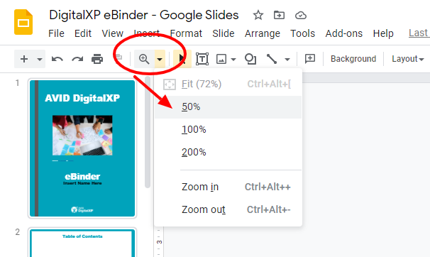
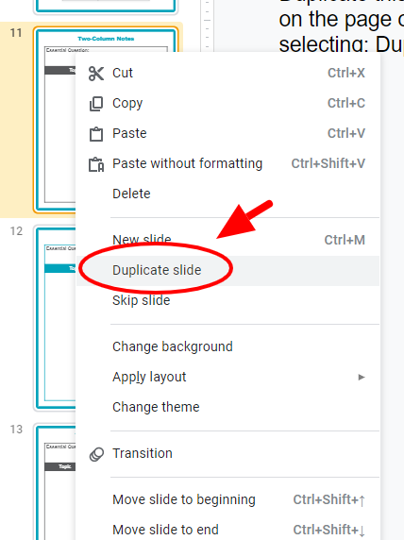
Technology Tips for Using this eBinder
Contents
Zoom out to see extra info and directions.
The gray space around the page is often used for added interactivity.
Task Pages
Resources
Use Ctrl+M to add a slide. To duplicate a page, right click on the page on the left and move where desired in your eBinder.
Help
Web links: Copy URLs to an eLearning page or collaborative activity and paste into your eBinder to access later.

Slide 4
AVID
Contents
Task Pages
Resources
Help
Task Pages

Slide 5
Task Page 1
Contents
Essential Question:
Focused Notes
Learning Artifacts
Instructional Practice Debrief
Task Pages
Consider adding links to your focused notes slides here.
Resources
Help
Consider adding links to your Learning Artifacts here.

Slide 6
Task Page 2
Contents
Essential Question:
Focused Notes
Learning Artifacts
Instructional Practice Debrief
Task Pages
Consider adding links to your focused notes slides here.
Resources
Help
Consider adding links to your Learning Artifacts here.

Slide 7
Task Page 3
Contents
Essential Question:
Focused Notes
Learning Artifacts
Instructional Practice Debrief
Task Pages
Consider adding links to your focused notes slides here.
Resources
Help
Consider adding links to your Learning Artifacts here.

Slide 8
AVID
Contents
Task Pages
Resources
Help
Resources

Slide 9
Contents
Essential Question:
Focused Notes
Learning Artifacts
Instructional Practice Debrief
Task Pages
Consider adding links to your focused notes slides here.
Resources
Duplicate this page by right clicking on the page on the left and selecting: Duplicate slide.
Help
Consider adding links to your Learning Artifacts here.
Click on the slide on the left and drag to the desired position in your eBinder.

Slide 10
Learning Artifacts
Learn more about learning artifacts at AVID.org.
Essential Question:
What are some examples of learning artifacts?
Learning Artifacts
This is a student-created product in which students capture the learning that happened in class and revise it in order to add the metacognitive hooks that support deeper understanding and recall of information.
SlideSnap
 | There are many ways to create a learning artifact. One type is a SlideSnap. SlideSnaps use multimedia to create metacognitive hooks to the work that identify what helped students in the learning process. SlideSnaps include an image, a text box, and an audio recording made by the student discussing the work. Click through the slides to see a description of each part of a SlideSnap and a blank template. Click here to make a copy of the SlideSnap Template.
Contents
Task Pages
Resources
Other ideas for learning artifacts include:
Brainstorming • Concept maps • Riddles • Illustrations • Cartoons • Poetry or songs • Metaphors and analogies • Compare-and-contrast diagrams • Data and graphs that are generated • Analysis writing • Reflection writing • Quickwrites • Four-square analogies • Mnemonics • Flow charts • Graphic organizers • Writing prompts • Other creative avenues for processing information
Help

Slide 11
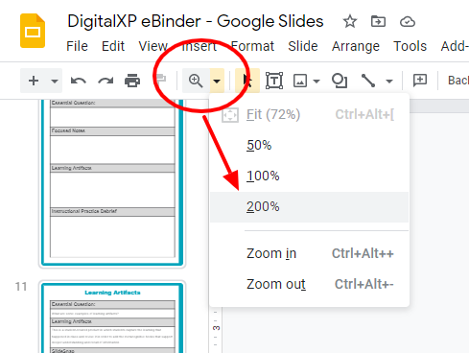
Contents
Zoom in to read the WICOR descriptions.
Task Pages
Resources
Help

Slide 12
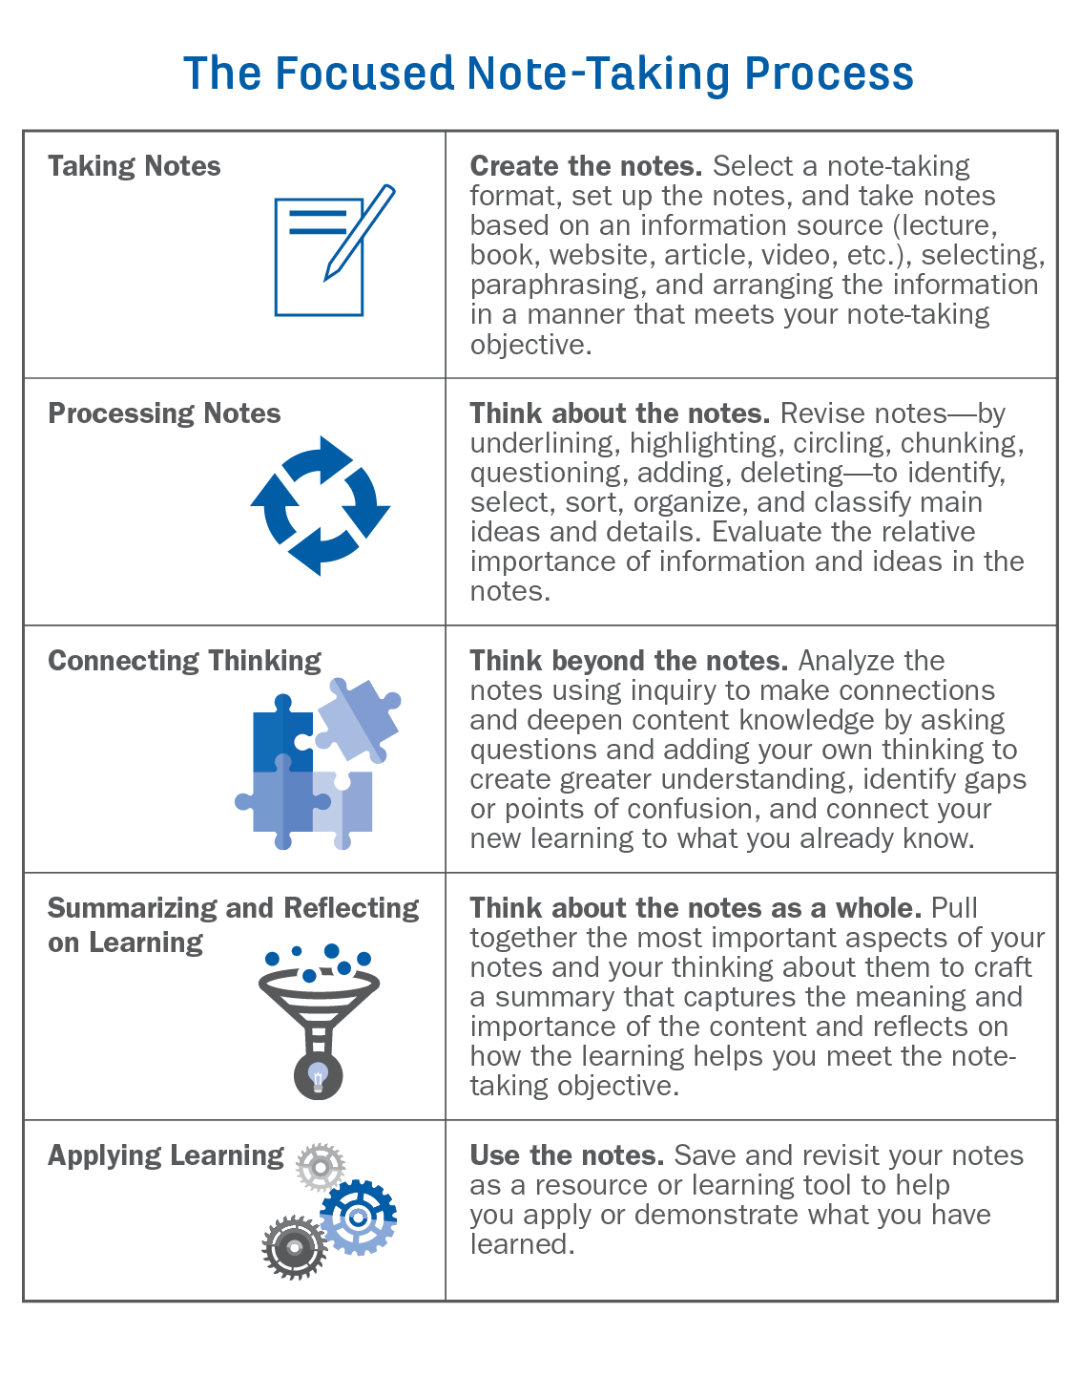
Focused Note-Taking Overview
AVID’s focused note-taking process has five phases. It is important to note that while applying learning is the last phase of the process, it is essential that it inform the first phase because the note-taking format should be shaped by the note-taking purpose. When teaching the focused note-taking process, educators need to determine how students will use their notes so they set up the format appropriately. It is crucial for educators to model and invite students to engage in this thought process so note-taking becomes a powerful, portable learning tool students can carry with them throughout their educational experience.
Contents
Task Pages
Resources
Help

Slide 13
Two-Column Notes
Contents
Essential Question:
Topic | Topic
Duplicate this page by right-clicking on the page on the left and selecting: Duplicate slide.
Task Pages
Resources
Help
Click on the slide on the left and drag to the desired position in your eBinder.
Quick Link to the Table of Contents

Slide 14
Two-Column Notes
Contents
Essential Question:
Topic | Topic
Duplicate this page by right clicking on the page on the left and selecting: Duplicate slide.
Task Pages
Resources
Help
Click on the slide on the left and drag to the desired position in your eBinder.
Quick Link to the Table of Contents

Slide 15
Three-Column Notes
Contents
Essential Question:
Topic | Topic | Topic
Duplicate this page by right-clicking on the page on the left and selecting: Duplicate slide.
Task Pages
Resources
Help
Click on the slide on the left and drag to the desired position in your eBinder.
Quick Link to the Table of Contents

Slide 16
Three-Column Notes
Contents
Table of Contents
Essential Question:
Topic | Topic | Topic
Duplicate this page by right-clicking on the page on the left and selecting: Duplicate slide.
Task Pages
Resources
Help
Click on the slide on the left and drag to the desired position in your eBinder.
Quick Link to the Table of Contents

Slide 17
Cornell Notes
Contents
Essential Question:
Questions | Notes
Summary
Duplicate this page by right-clicking on the page on the left and selecting: Duplicate slide.
Task Pages
Resources
Help
Click on the slide on the left and drag to the desired position in your eBinder.

Slide 18
Cornell Notes
Contents
Essential Question:
Questions | Notes
Summary
Duplicate this page by right-clicking on the page on the left and selecting: Duplicate slide.
Task Pages
Resources
Help
Click on the slide on the left and drag to the desired position in your eBinder.

Slide 19
AVID
Contents
Task Pages
Resources
Help
Help

Slide 20
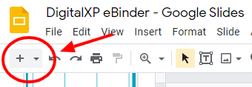
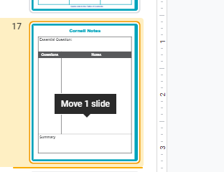
Help!
Add a page to your eBinder
Click the PLUS button on the top left of the toolbar. (CTRL+M)
Move a page in your eBinder
Click and hold on a page, then drag it to your desired location.
Duplicate a page in your eBinder
Right-click on the page then select Duplicate from the menu.
Contents
Zoom out to see extra info and directions.
The gray space around the page is often used for added interactivity.
Task Pages
Resources
Help

